Slide 1
Chapter 4: Threads

Slide 2
Motivation
Most modern applications are multithreaded
Threads run within application
Multiple tasks with the application can be implemented by separate threads
Update display
Fetch data
Spell checking
Answer a network request
Process creation is heavy-weight while thread creation is light-weight
Can simplify code, increase efficiency
Kernels are generally multithreaded

Slide 3
Processes and Threads

Slide 4
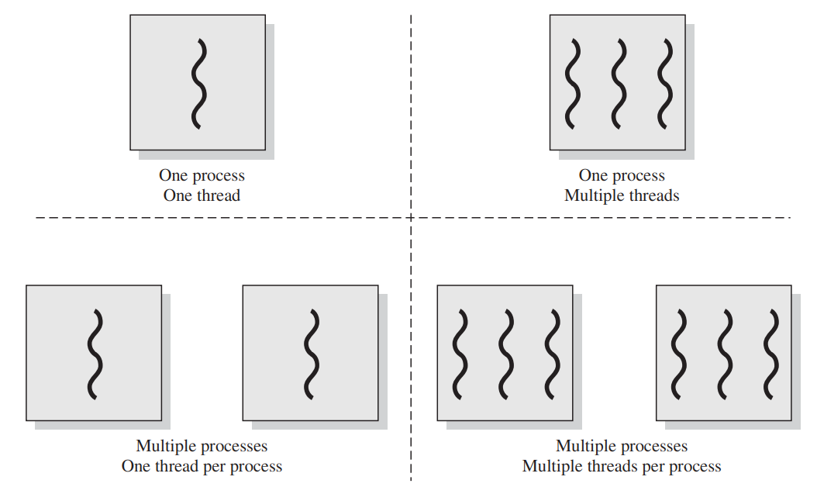
Multithreading

Slide 5
Multithreading - Structure

Slide 6
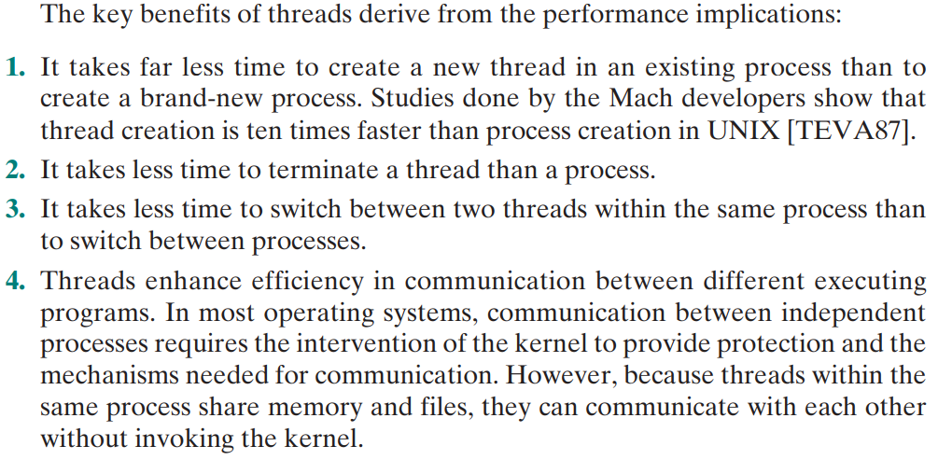
Benefits of Threading

Slide 7
ULT

Slide 8
Advantages of ULT

Slide 9
Dis-advantages of ULT

Slide 10
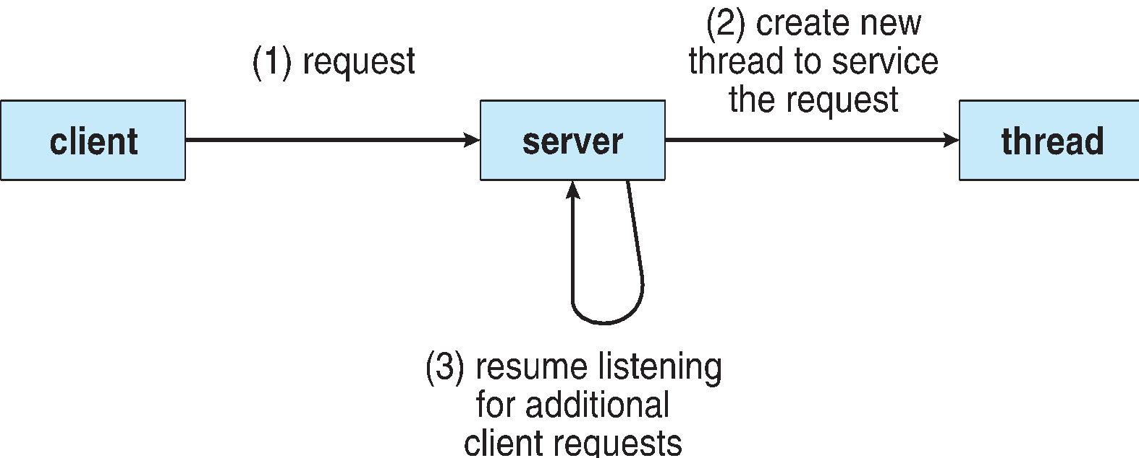
Multithreaded Server Architecture

Slide 11
Benefits
Responsiveness – may allow continued execution if part of process is blocked, especially important for user interfaces
Resource Sharing – threads share resources of process, easier than shared memory or message passing
Economy – cheaper than process creation, thread switching lower overhead than context switching
Scalability – process can take advantage of multiprocessor architectures

Slide 12
Multicore Programming
Multicore or multiprocessor systems putting pressure on programmers, challenges include:
Dividing activities
Balance
Data splitting
Data dependency
Testing and debugging
Parallelism implies a system can perform more than one task simultaneously
Concurrency supports more than one task making progress
Single processor / core, scheduler providing concurrency

Slide 13
Multicore Programming (Cont.)
Types of parallelism
Data parallelism – distributes subsets of the same data across multiple cores, same operation on each
Task parallelism – distributing threads across cores, each thread performing unique operation
As # of threads grows, so does architectural support for threading
CPUs have cores as well as hardware threads
Consider Oracle SPARC T4 with 8 cores, and 8 hardware threads per core

Slide 14
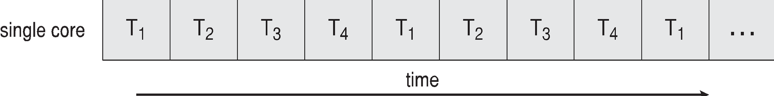
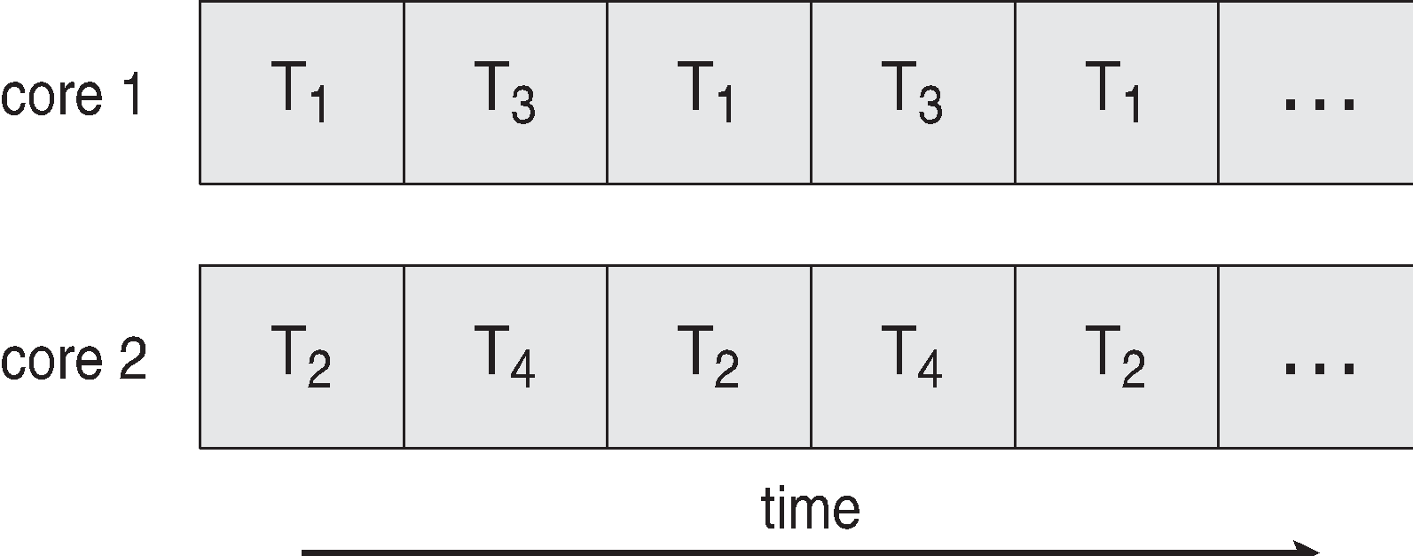
Concurrency vs. Parallelism
Concurrent execution on single-core system:
Parallelism on a multi-core system:

Slide 15
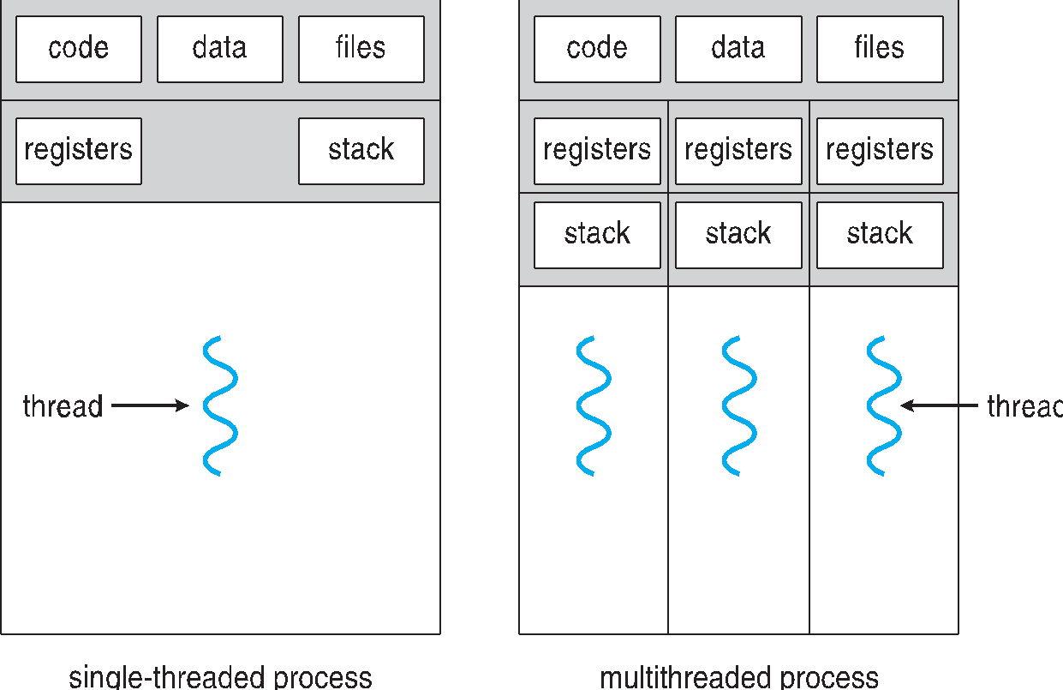
Single and Multithreaded Processes

Slide 16
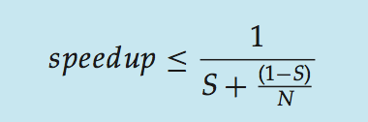
Amdahl’s Law
Identifies performance gains from adding additional cores to an application that has both serial and parallel components
S is serial portion
N processing cores
That is, if application is 75% parallel / 25% serial, moving from 1 to 2 cores results in speedup of 1.6 times
As N approaches infinity, speedup approaches 1 / S
Serial portion of an application has disproportionate effect on performance gained by adding additional cores
But does the law take into account contemporary multicore systems?

Slide 17
User Threads and Kernel Threads
User threads - management done by user-level threads library
Three primary thread libraries:
POSIX Pthreads
Windows threads
Java threads
Kernel threads - Supported by the Kernel
Examples – virtually all general purpose operating systems, including:
Windows
Solaris
Linux
Tru64 UNIX
Mac OS X

Slide 18
Multithreading Models
Many-to-One
One-to-One
Many-to-Many

Slide 19
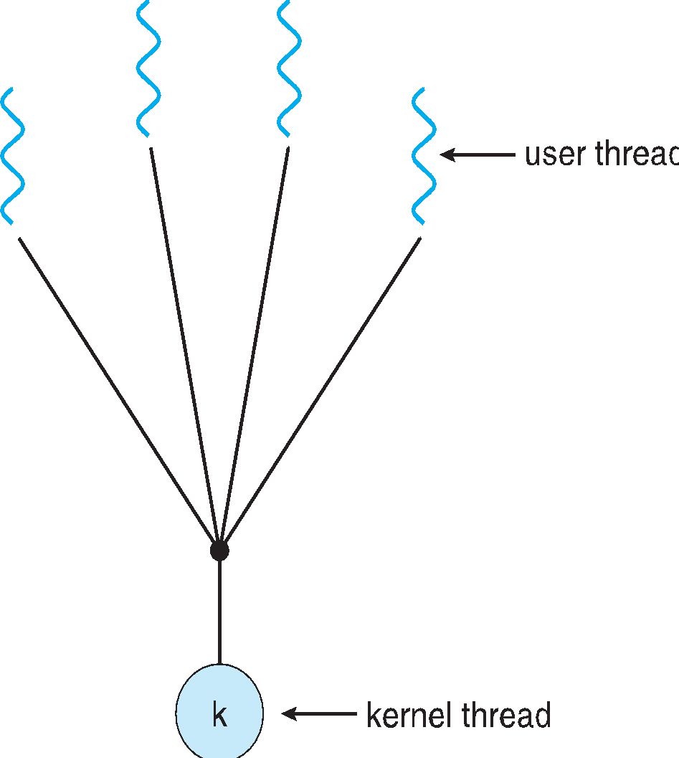
Many-to-One
Many user-level threads mapped to single kernel thread
One thread blocking causes all to block
Multiple threads may not run in parallel on muticore system because only one may be in kernel at a time
Few systems currently use this model
Examples:
Solaris Green Threads
GNU Portable Threads

Slide 20
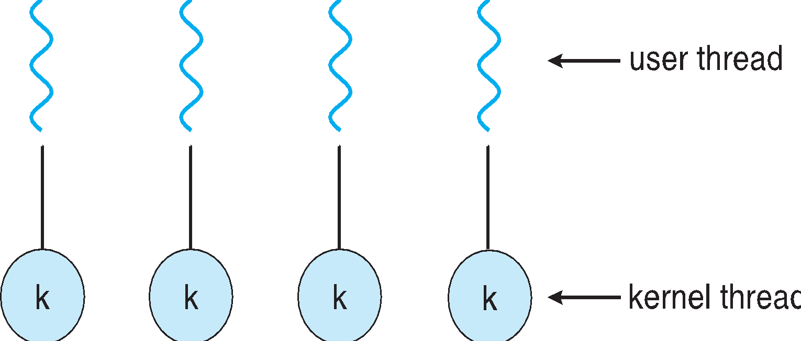
One-to-One
Each user-level thread maps to kernel thread
Creating a user-level thread creates a kernel thread
More concurrency than many-to-one
Number of threads per process sometimes restricted due to overhead
Examples
Windows
Linux
Solaris 9 and later

Slide 21
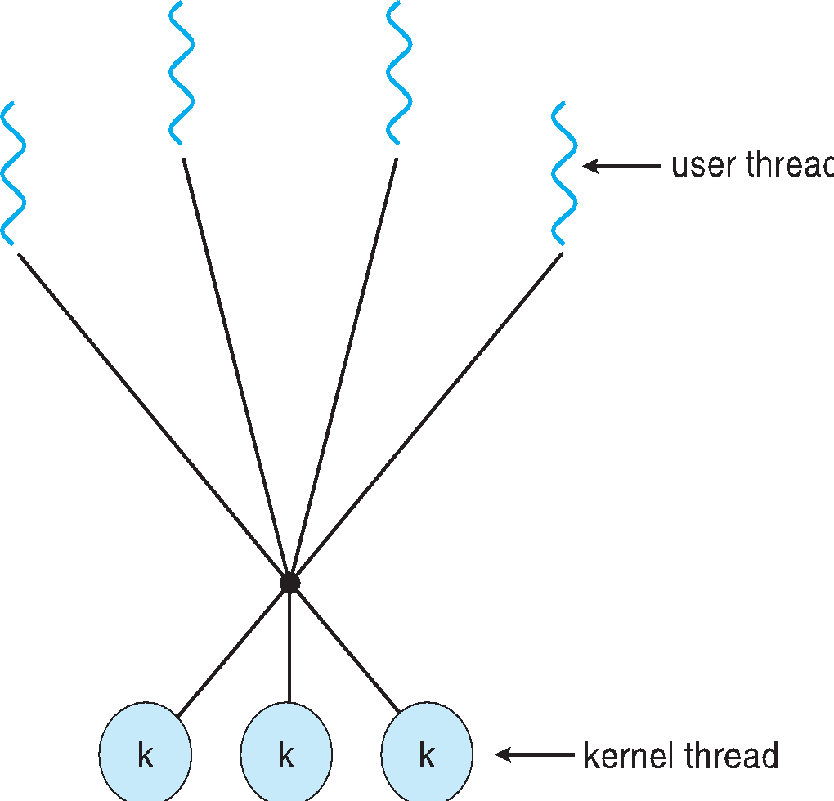
Many-to-Many Model
Allows many user level threads to be mapped to many kernel threads
Allows the operating system to create a sufficient number of kernel threads
Solaris prior to version 9
Windows with the ThreadFiber package

Slide 22
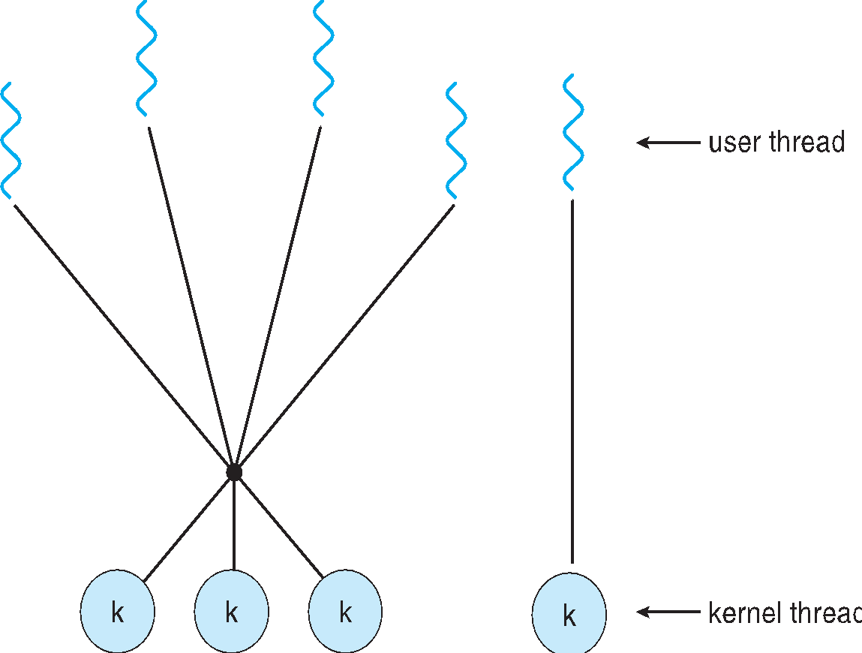
Two-level Model
Similar to M:M, except that it allows a user thread to be bound to kernel thread
Examples
IRIX
HP-UX
Tru64 UNIX
Solaris 8 and earlier

Slide 23
Thread Libraries
Thread library provides programmer with API for creating and managing threads
Two primary ways of implementing
Library entirely in user space
Kernel-level library supported by the OS

Slide 24
Pthreads
May be provided either as user-level or kernel-level
A POSIX standard (IEEE 1003.1c) API for thread creation and synchronization
Specification, not implementation
API specifies behavior of the thread library, implementation is up to development of the library
Common in UNIX operating systems (Solaris, Linux, Mac OS X)

Slide 25
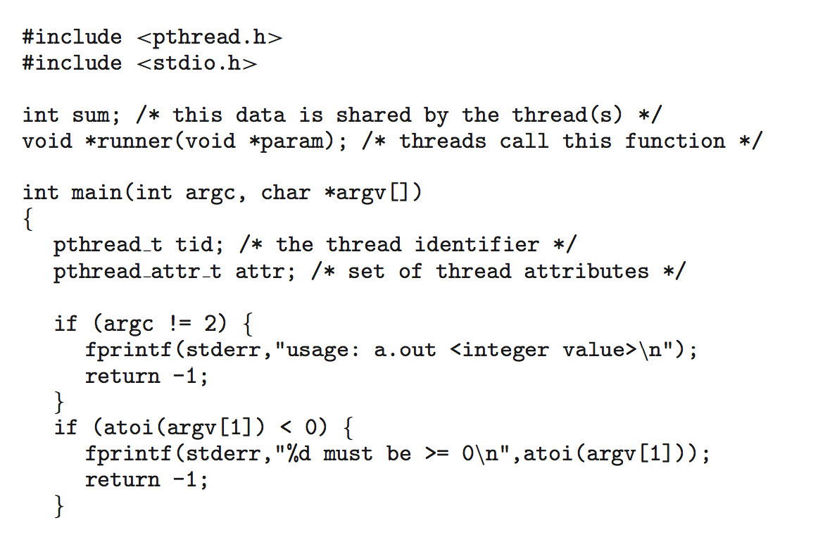
Pthreads Example

Slide 26
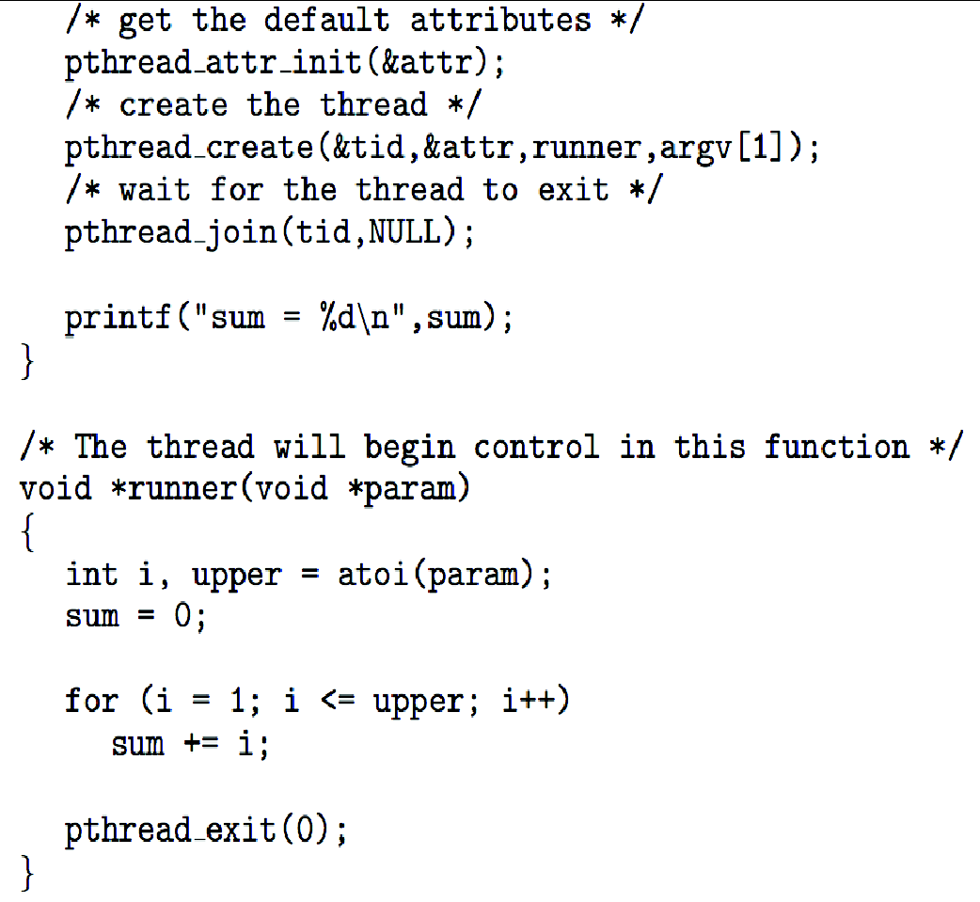
Pthreads Example (Cont.)

Slide 27
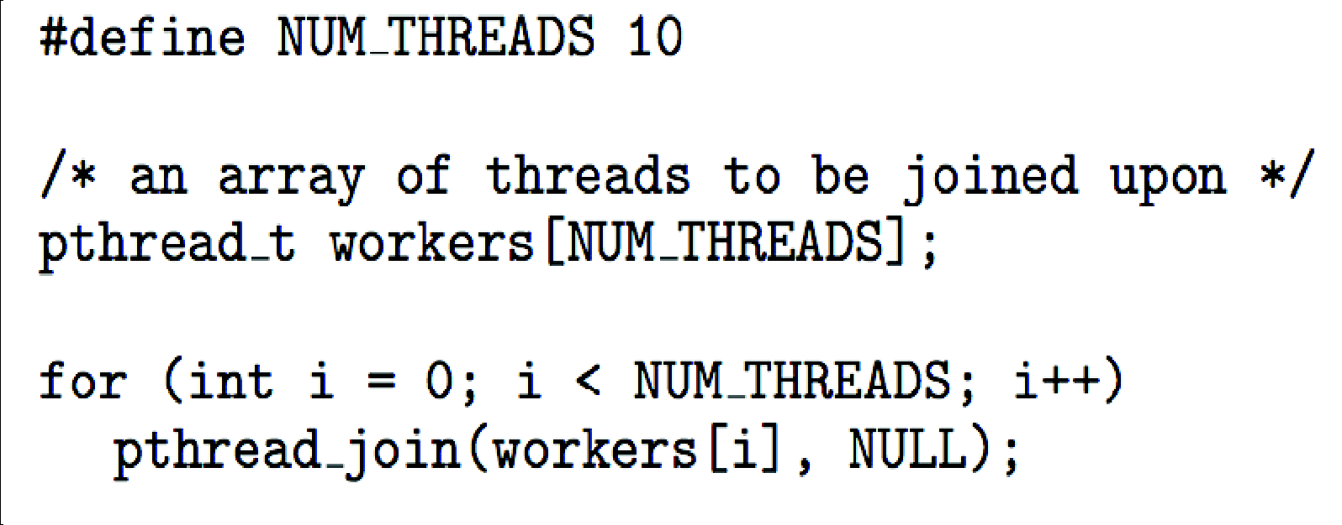
Pthreads Code for Joining 10 Threads

Slide 28
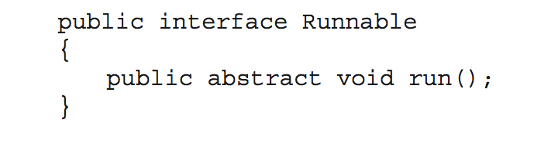
Java Threads
Java threads are managed by the JVM
Typically implemented using the threads model provided by underlying OS
Java threads may be created by:
Extending Thread class
Implementing the Runnable interface

Slide 29
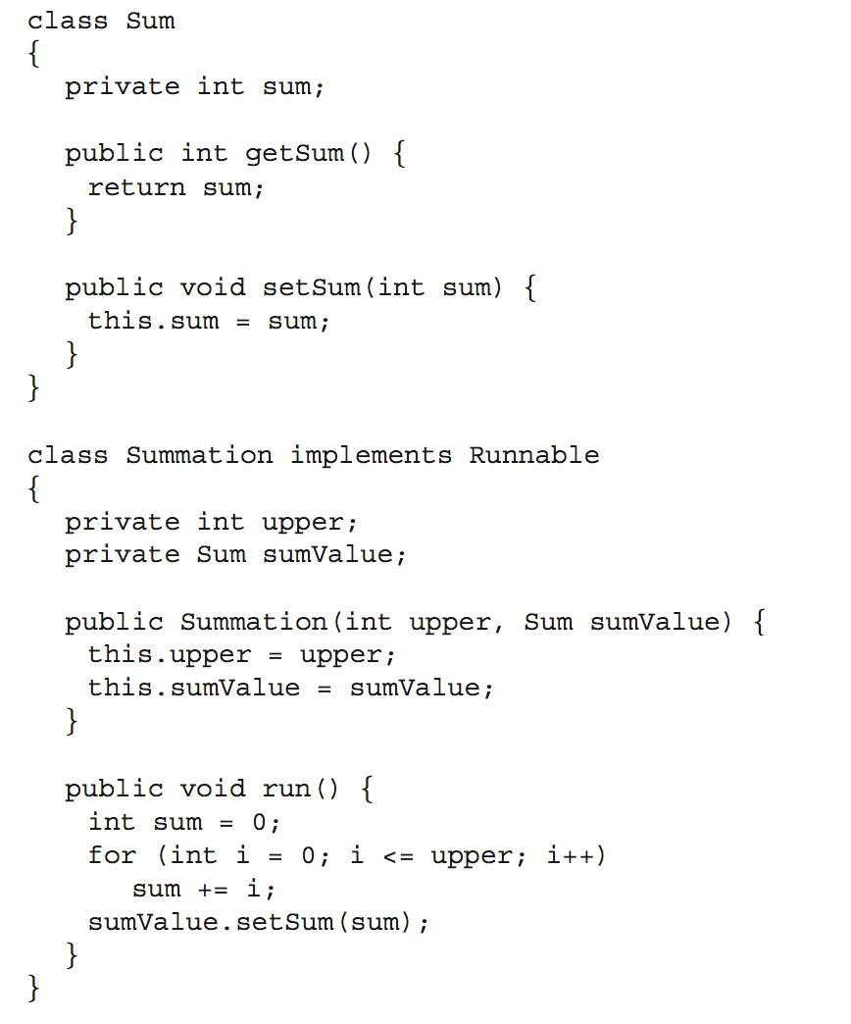
Java Multithreaded Program

Slide 30
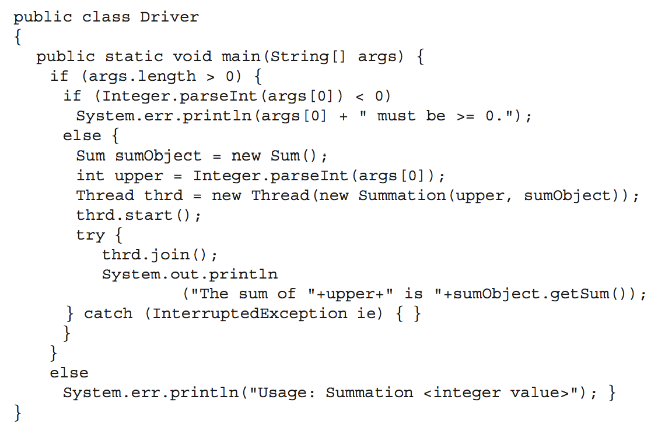
Java Multithreaded Program (Cont.)

Slide 31
Implicit Threading
Growing in popularity as numbers of threads increase, program correctness more difficult with explicit threads
Creation and management of threads done by compilers and run-time libraries rather than programmers
Three methods explored
Thread Pools
OpenMP
Grand Central Dispatch
Other methods include Microsoft Threading Building Blocks (TBB), java.util.concurrent package

Slide 32
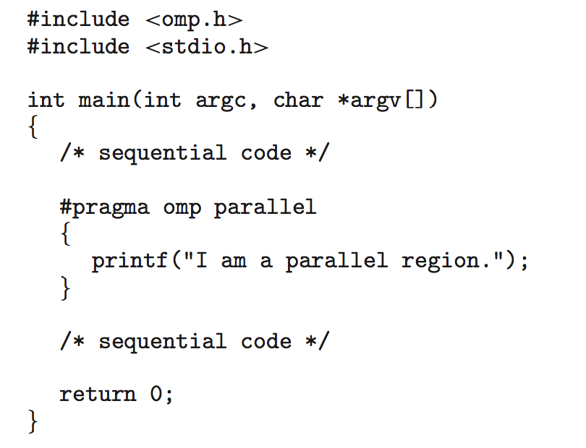
OpenMP
Set of compiler directives and an API for C, C++, FORTRAN
Provides support for parallel programming in shared-memory environments
Identifies parallel regions – blocks of code that can run in parallel
#pragma omp parallel
Create as many threads as there are cores
#pragma omp parallel for for(i=0;i<N;i++) {
c[i] = a[i] + b[i];
}
Run for loop in parallel

